Slide 1
University of Arizona ASCEND
2011-2012 Symposium
Team: UA SEDS

Slide 2
The Team: UA SEDS
Alison Bradbury
Amanda Urquiza
Andrew McGuckin
Brittany Torgrude
Danny Pagano
Nathan Mogk
Sara B Meschberger
Notes:
Fill in actual list

Slide 3
The Goal: ASCEND 2012
Our goal this semester…
Optimize structure and aerogel
Work with circuit boards
Build a cosmic ray detector
Record flight with 3 video cameras
Analyze data and results
Notes:
Actual experiment goal, staying in budget, new structural design, first time members few returners, weight limit. Fill in Picture

Slide 4
The Process
Notes:
Clearly we need to go into more detail when discussing this slide.

Slide 5
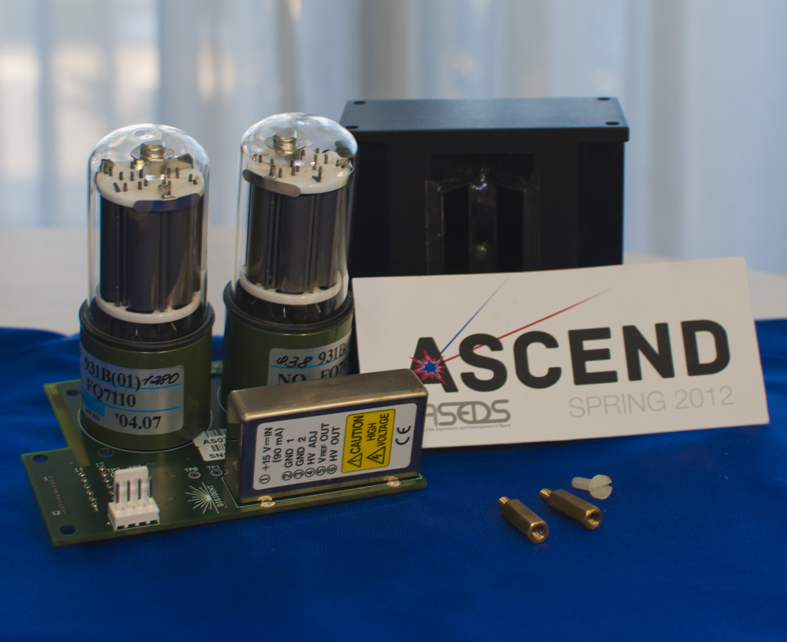
The Experiment: Cosmic Ray Detector
This experiment is intended to detect cosmic rays at alternate altitudes.
The experiment expects to measure the effect of altitude on the number of cosmic ray impacts in a scintillation detector.
Notes:
Talk about the experiment, arduino, and final goal. Insert CURRENT picture of arduino and new speakers

Slide 6
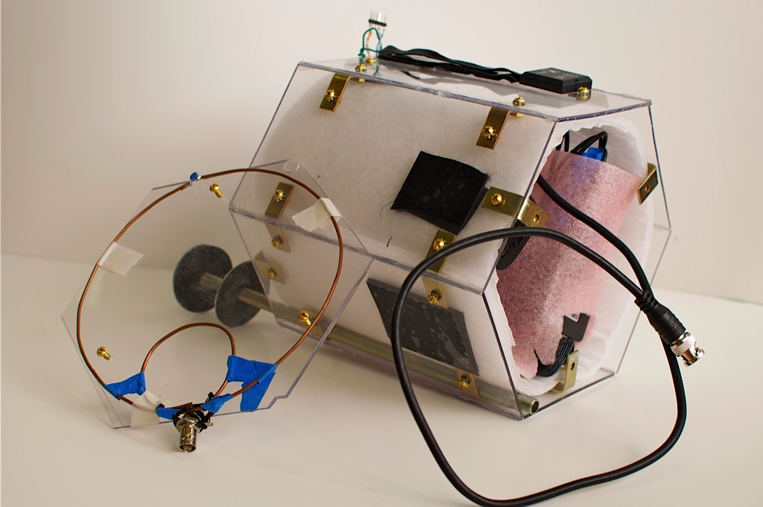
The Structure: Hexagonal Prism
Individually cut Lexan polycarbonate facets
Fastened with brass brackets
Edges sealed with silicone sealant
4’’X 8’’X 1/10’’ and weighs 1/3 the weight of acrylic
Notes:
Discuss purpose of the polycarbonate sheets, sliding panels, unique shape. Insert PICTURE

Slide 7
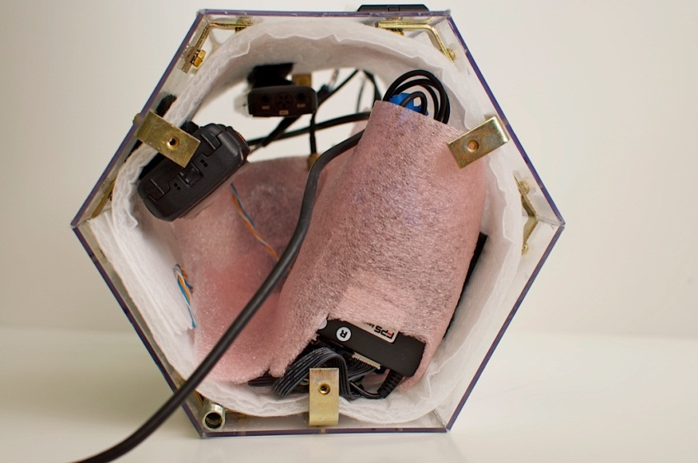
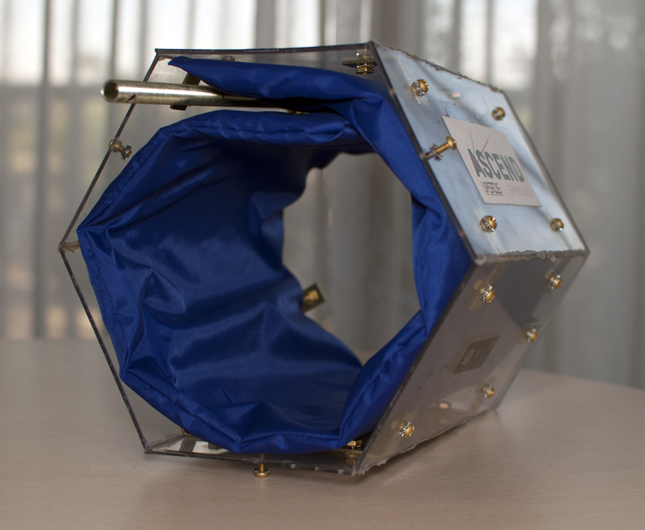
The Thermal Components
Aerogel blanket for insulation
Silica-based
Entire blanket was less than one ounce
Silica aerogel is one of the world’s lowest density solids
Testing its insulating ability
Wrapped aerogel in a nylon sheath
Notes:
Why we went with the blanket. What other ways we are insulating our experiment.

Slide 8
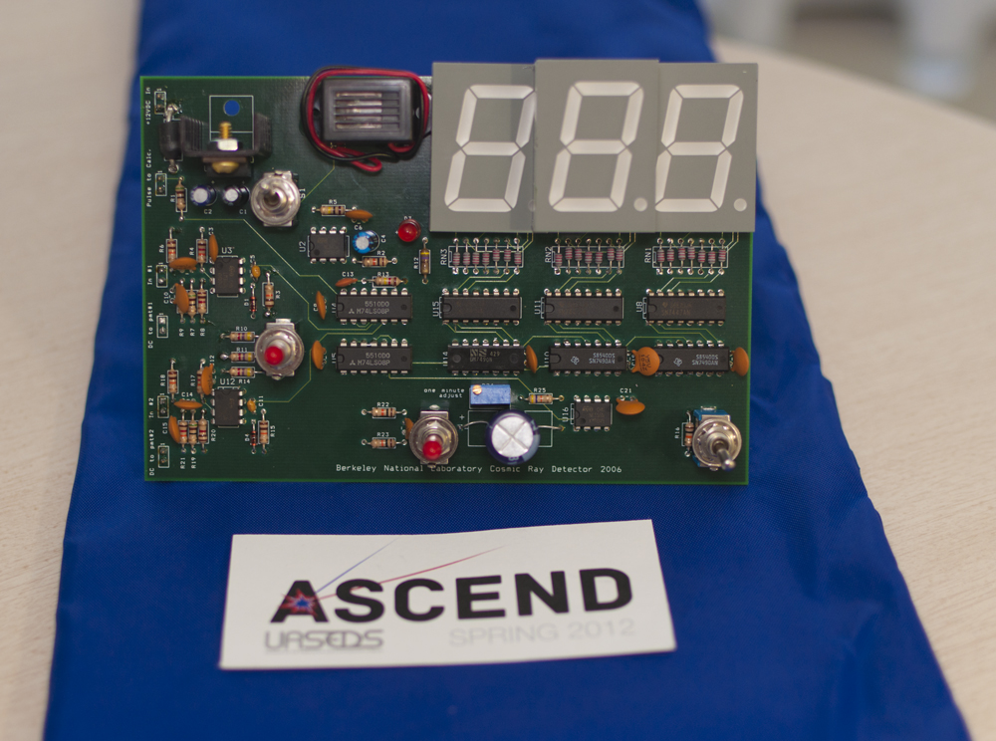
The Electronic Components
Circuit board with large LED counters
Photomultipliers
MUVI cameras
Notes:
Reason for using Rockoon Teams electronics box. Insert Picture

Slide 9
Results
Fall 2011:
Did not receive frequency data due to recorder malfunction
Structure deemed successful
Spring 2012:
Received 4 hours of video recordings from both panoramic cameras
Successfully recorded data from the scintillator
Recorded frequency sweep at various altitudes
Reused structure

Slide 10
Any questions?

